Slide 1


Introduction to Urban Big Data and Machine Learning
CRP 3850/5850 Special Topics (2024 Summer)
Lecture 15 Machine Learning (II)
Wenzheng Lee
Yujin Li
06/21/2024

Slide 2
Announcement
All assignments (1-4) should be submitted no later than Friday.
Friday Afternoon: 7-10 minutes presentation
Final poster due: Sunday night

Slide 3
OUTLINE
Introduction to Machine Learning
What is machine learning?
Machine learning types
Supervised Learning
Classification and Regression
Unsupervised Learning
Clustering

Slide 4
1
Quick Review

Slide 5
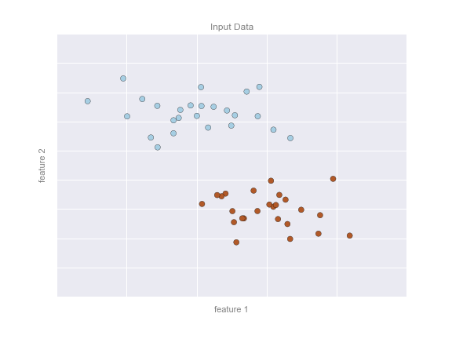
Supervised learning: Classification
Let’s look at some examples

Slide 6
Supervised learning: Classification
Let’s look at some examples
Here, we have a two-dimensional (read: two columns) dataset
We know which dots are blue and which are red.

Slide 7
Supervised learning: Classification
Let’s look at some examples
Here, we have a two-dimensional (read: two columns) dataset
We know which dots are blue and which are red.
The classification question then asks:
Can we create a “separator” model that separates these two points?

Slide 8
Supervised learning: Classification
Model: the quantitative version of “there is a straight line that can separate the two classes”.
Parameters: the intercept and axis (or however else we want to define our line) that describes the line

Slide 9
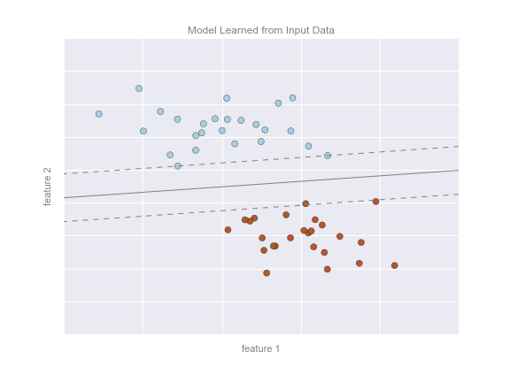
Supervised learning: Classification
So our model could look like this on the right.

Slide 10
Which is classification problem?
An e-commerce company using labeled customer data to predict whether or not a customer will purchase a particular item
A restaurant using review data to ascribe positive or negative sentiment to a given review
A bike share company using time and weather data to predict the number of bikes being rented at any given hour

Slide 11
Which is classification problem?
An e-commerce company using labeled customer data to predict whether or not a customer will purchase a particular item
A restaurant using review data to ascribe positive or negative sentiment to a given review
A bike share company using time and weather data to predict the number of bikes being rented at any given hour

Slide 12
Which is classification problem?
A regression problem is when we try to use any type (continuous or categorical) of data to predict outcomes that are continuous.

Slide 13
Regression vs Classification
A regression problem is when we try to use any type (continuous or categorical) of data to predict outcomes that are continuous.
A classification problem is when we try to use any type (continuous or categorical) of data to predict outcomes that are categorical.

Slide 14
Model Validation: Train-Test Split
Once we have trained our model, i.e. described this function that best separates our two classes (in this case), we can use the model to generalize and make new predictions

Slide 15
Model Validation: Train-Test Split
We typically split our data into train and test sets to evaluate the performance of a model.
The training set is used to find the model
The test set is used to evaluate the performance

Slide 16
Model Validation: Train-Test Split
We want to give the model new, unseen data.
We do this to ensure the model can generalize well.

Slide 17
Model Validation: Train-Test Split
How do we divide the train and test set? No one-size-fits-all rule.
A common breakdown is 70/30 or 80/20 train vs test

Slide 18
Model Validation: Train-Test Split
The split might be determined by:
How big the overall data is. If the data is already pretty small, then you might want a larger training set to get enough data to learn.
If the data is large, perhaps a smaller split is fine.

Slide 19
Model Validation: Train-Test Split
You need to make sure your training data is representative of the larger sample.

Slide 20
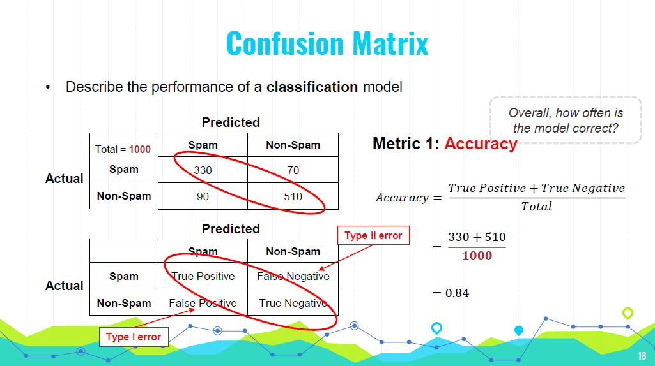
20
Notes:
a Type I error would mean marking a legitimate email as spam. This could result in missing important emails.
In medical testing, it could mean diagnosing a healthy person as having a disease, leading to unnecessary stress and treatment.
a Type II error would mean marking a spam email as legitimate.
In medical testing, it could mean failing to diagnose a person with a disease

Slide 21
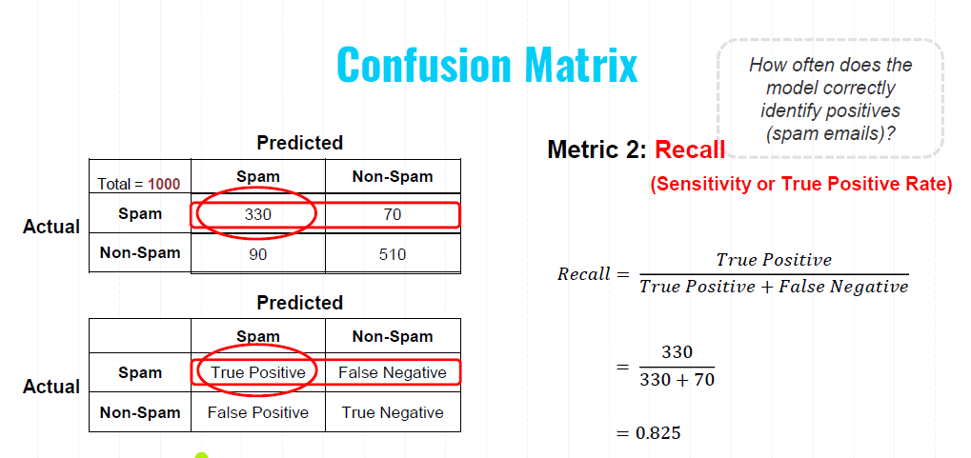
21
Notes:
Recall, also known as sensitivity or the true positive rate, measures how often the model correctly identifies positive instances (in this case, spam emails).

Slide 22
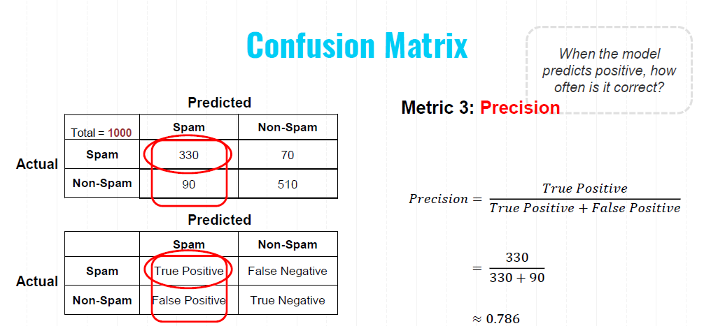
22
Notes:
Precision measures how often the model's positive predictions are correct. It focuses on the quality of the positive predictions made by the model.

Slide 23
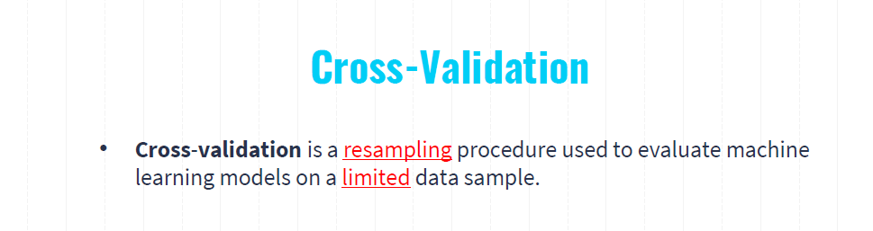
Splitting the Data: The dataset is split into K equal-sized (or nearly equal-sized) subsets.
Training and Validation: The model is trained K times, each time using K-1 folds for training and the remaining 1 fold for validation.
Rotation: The validation fold is rotated such that each of the K folds is used exactly once as the validation set.
Averaging the Results: The performance metric (e.g., accuracy, precision, recall) is averaged across all K trials to give an overall performance estimate.

Slide 24
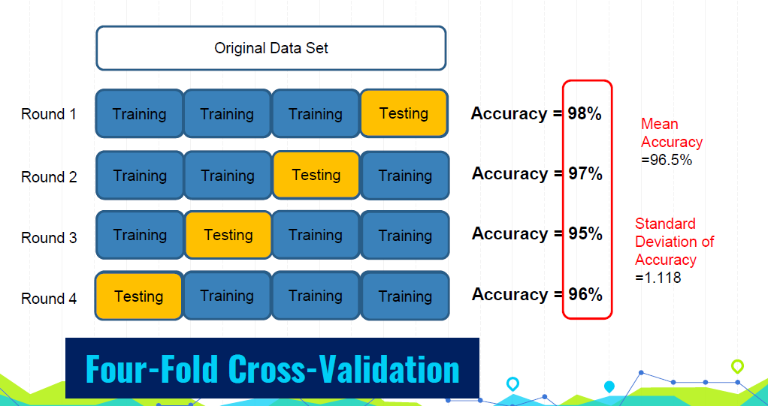
Notes:
Bias-Variance Tradeoff: A larger K results in lower bias but higher variance of the performance estimate. Conversely, a smaller K results in higher bias but lower variance.
Common Choices: Typically, K is set to 5 or 10, as these values have been shown to provide a good balance between computational efficiency and reliable performance estimates.

Slide 25

Hyperparameter Tuning
Hyperparameter: model parameters specified in advance (before training)
What threshold to use?
What k to use?
?
𝒚
?
?
𝒙_{𝟏}
1 Nearest Neighbor
1
𝒙_{𝟏}
0.5
3 Nearest Neighbor
0.3
0
𝒙_{𝟏}
𝒙_{𝟏}
Logistic Regression
K-Nearest Neighbors

Slide 26
Machine Learning Steps
Gathering and loading data
Exploring data (e.g., pandas and visualization)
Transforming data (e.g., string to numeric)
Splitting data for training and testing
Choosing and creating a model
Training
Testing (evaluating accuracy)
Tuning the model (hyperparameters)
Making predictions on new data

Slide 27
2
Supervised Learning Algorithms

Slide 28
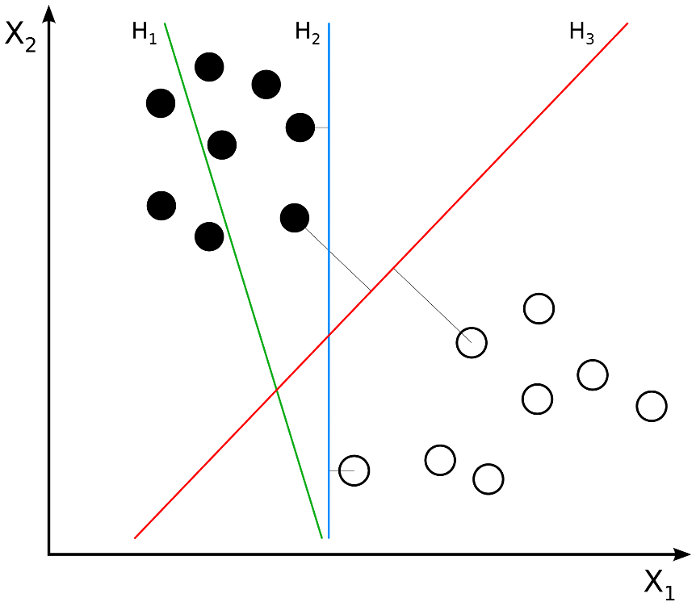
Support Vector Machine
Objective: To find a line or plane (in higher dimensions) that maximizes the distance between the line/plane and the nearest training data points of any class
Key Concept:
The maximum-margin hyperplane.
Margin: the distance between the hyperplane and the closest data points from either class.
These closest points are called support vectors.
margin is maximized equally for both classes.

Slide 29
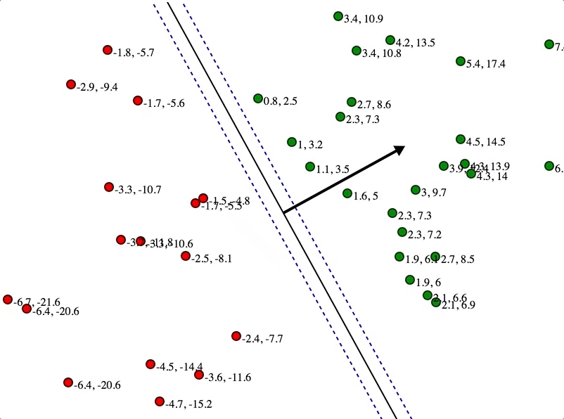
Support Vector Machine
Here, these numbers represent distances to the line
Initial State:
The algorithm starts with an initial guess for the hyperplane.
The algorithm iteratively adjusts the position and orientation of the hyperplane. Tweaking the parameters to improve the separation.
Notes:
Arrow: The black arrow in the image indicates the direction of the maximum margin. It is perpendicular to the hyperplane and shows the vector w\mathbf{w}w, which is the normal to the hyperplane.
Initial State:
Data Points: Initially, the data points (red and green circles) are plotted on the map with no hyperplane drawn.
Objective: The goal is to find the optimal hyperplane that separates the two classes with the maximum margin.
Drawing Initial Hyperplane:
First Attempt: The algorithm starts with an initial guess for the hyperplane. This initial hyperplane may not be optimal and might not maximize the margin.
Iterative Adjustment:
Adjusting the Hyperplane: The algorithm iteratively adjusts the position and orientation of the hyperplane. This involves tweaking the parameters w\mathbf{w}w (weight vector) and bbb (bias term) to improve the separation.
C: Regularization parameter that controls the trade-off between maximizing the margin and minimizing the classification error.Kernel Parameters: If a kernel SVM is used, parameters related to the kernel function (e.g., the gamma parameter in an RBF kernel).

Slide 30
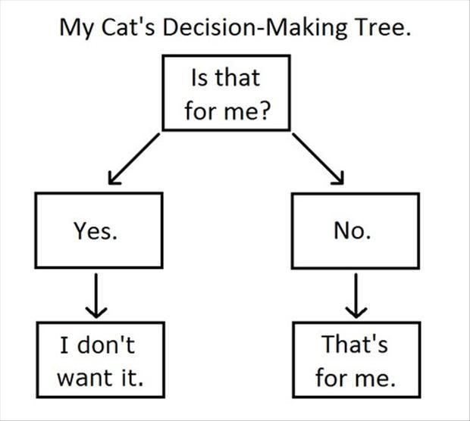
Decision Trees

Slide 31
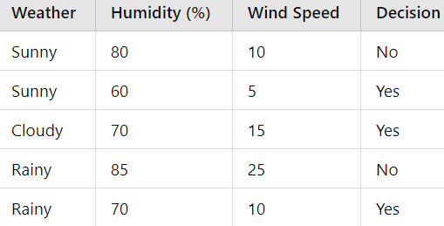
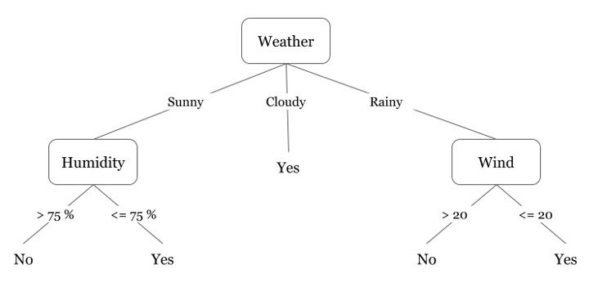
Decision Trees
Did I play badminton for each day of the week?
Decision Tree:
a model that makes decisions by splitting data into subsets based on feature values
each node represents a feature
each branch represents a decision rule
each leaf node represents an outcome
Notes:
Collecting Data: Gather the dataset with features and labels.
Choosing the Best Feature to Split: Use criteria like Gini impurity or information gain to determine the best feature to split the data at each node.
Recursive Splitting: Continue splitting the data at each node until stopping criteria are met (e.g., maximum depth, minimum samples per node).
Prediction: For a new instance, traverse the tree from the root to a leaf based on the feature values of the instance to get the predicted label.
Gini impurity measures the likelihood of an incorrect classification of a randomly chosen element.

Slide 32
Decision Trees
Did I play badminton for each day of the week?
Choosing the Best Feature and threshold to Split:
Gini impurity
Entropy (Information Gain)
Recursive Splitting:
Continue splitting at each node until stopping criteria are met (e.g., maximum depth, minimum samples per node)
Prediction
Notes:
Collecting Data: Gather the dataset with features and labels.
Choosing the Best Feature to Split: Use criteria like Gini impurity or information gain to determine the best feature to split the data at each node.
Recursive Splitting: Continue splitting the data at each node until stopping criteria are met (e.g., maximum depth, minimum samples per node).
Prediction: For a new instance, traverse the tree from the root to a leaf based on the feature values of the instance to get the predicted label.
Gini impurity measures the likelihood of an incorrect classification of a randomly chosen element.

Slide 33
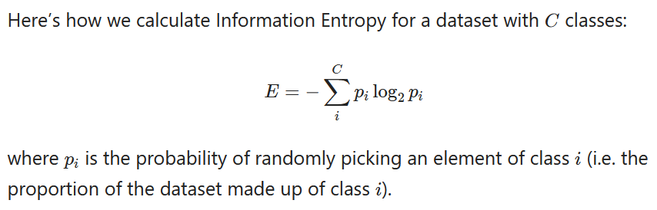
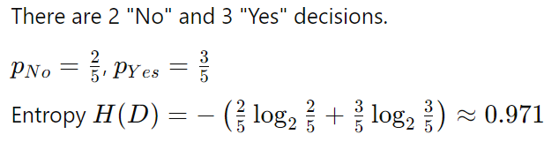
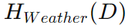
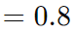
Decision Trees
Did I play badminton for each day of the week?
The Entropy of the root node:
Weighted average entropy for weather:
Information Gain
Notes:
Collecting Data: Gather the dataset with features and labels.
Choosing the Best Feature to Split: Use criteria like Gini impurity or information gain to determine the best feature to split the data at each node.
Recursive Splitting: Continue splitting the data at each node until stopping criteria are met (e.g., maximum depth, minimum samples per node).
Prediction: For a new instance, traverse the tree from the root to a leaf based on the feature values of the instance to get the predicted label.
Gini impurity measures the likelihood of an incorrect classification of a randomly chosen element.

Slide 34
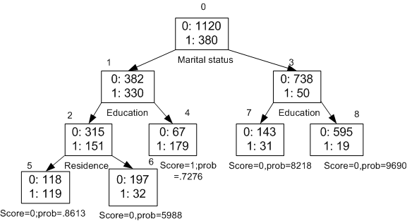
Decision Trees
What causes someone to make big purchases?
the counts of instances that do not make big purchases (0) and those that do (1).
Notes:
Each split aims to separate the data into more homogeneous subsets concerning the target variable (making a big purchase or not).

Slide 35
Decision Trees
What causes someone to make big purchases?
We are going to select a split in the tree that is best able to separate our data into its purest target classes.
Purity: how similar the instances within a subset are in terms of the target variable.
Root node splits: marital status is a significant factor in determining big purchases

Slide 36
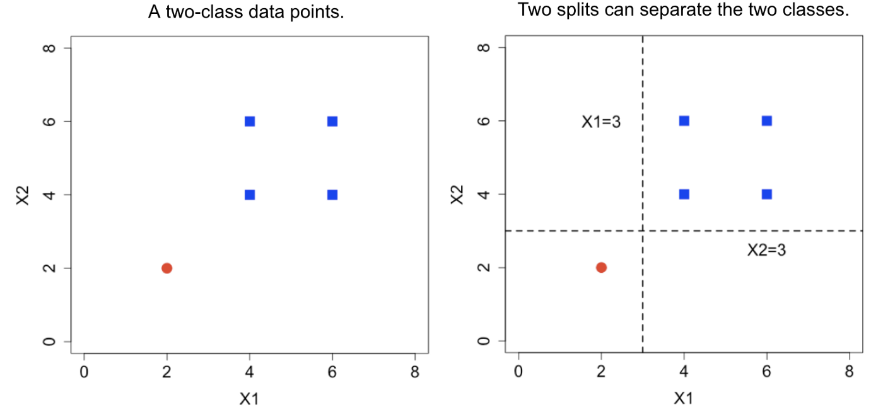
Decision Trees
This is another way to visualize the decision tree
First Split (X1 = 3):
Second Split (X2 = 3)
Notes:
X1 and X2X2X2 are the two features or dimensions of the data.

Slide 37
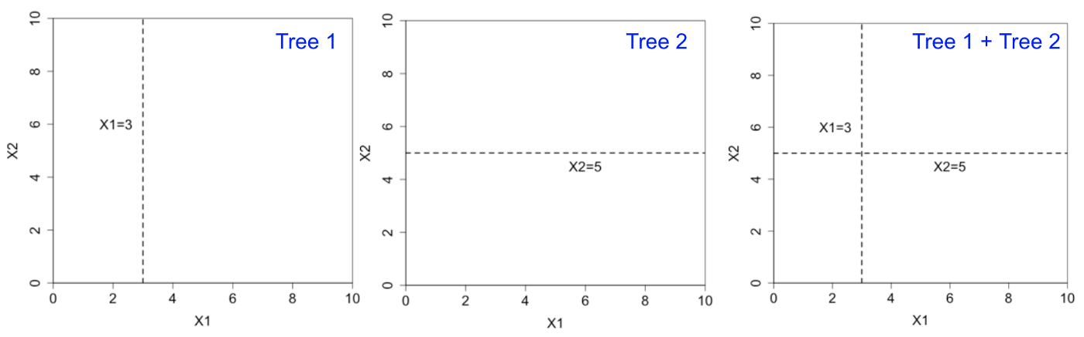
Ensemble Methods: combine the predictions of multiple models
Imagine if we had multiple (typically shallow) trees
Notes:
Ensemble methods combine the predictions of multiple models (typically decision trees) to produce a more accurate and robust prediction. The idea is that multiple models can capture different aspects of the data, and their combined prediction is better than any single model.

Slide 38
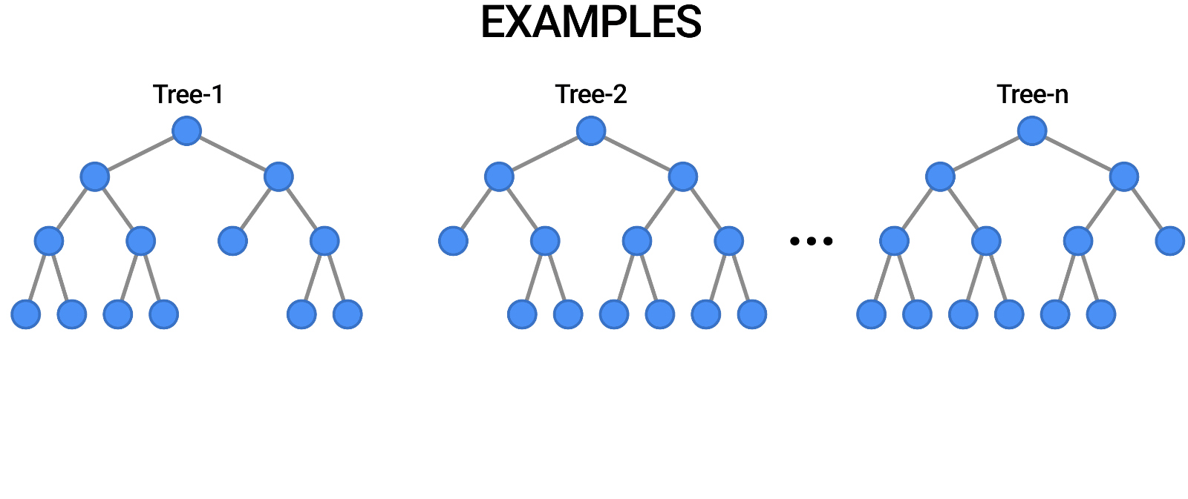
Ensemble Methods: Random Forest
Tree in the random forest is trained on a subset of the data and a random subset of the input features.
So, each tree makes decisions based on a different subset of features.
To predict a new data point, the random forest takes the majority vote of the predictions of all the individual decision trees.
Notes:
This is another way to visu

Slide 39
3
Unsupervised Learning

Slide 40
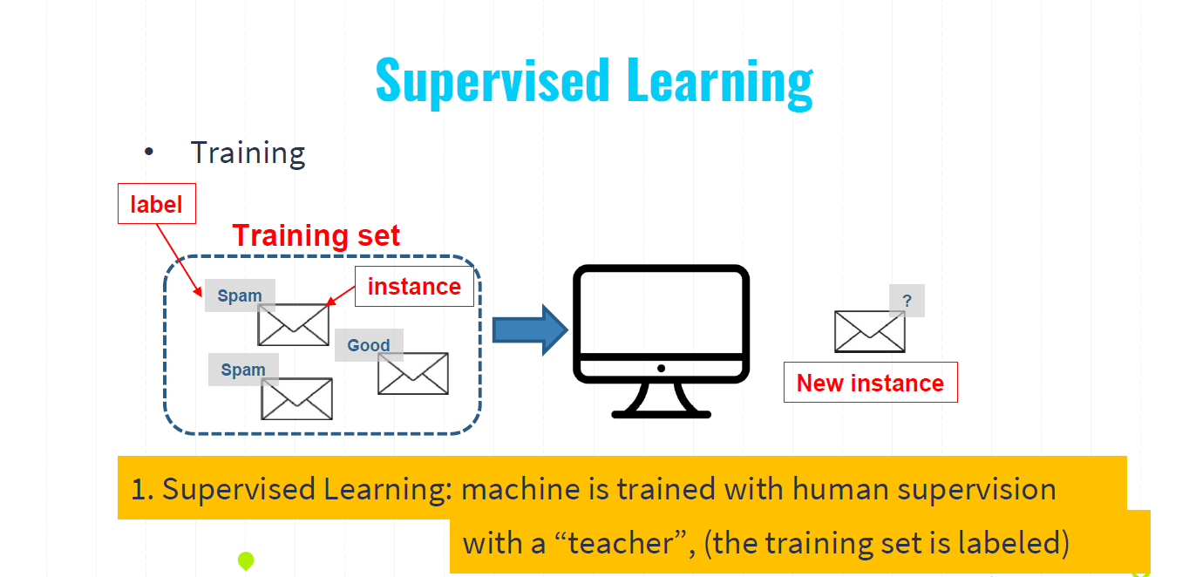

Slide 41
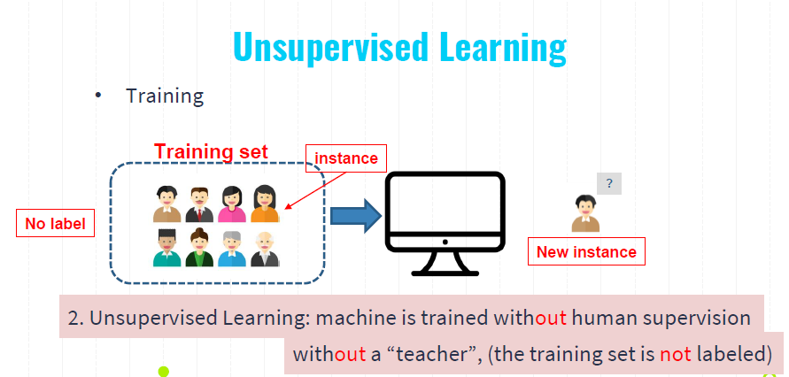

Slide 42
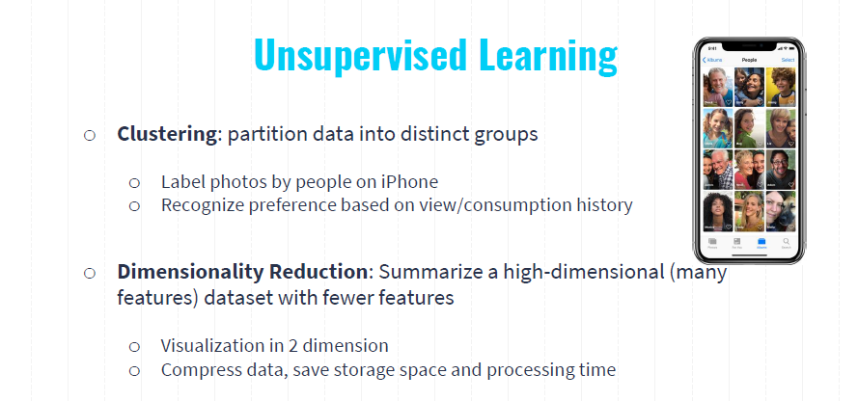

Slide 43
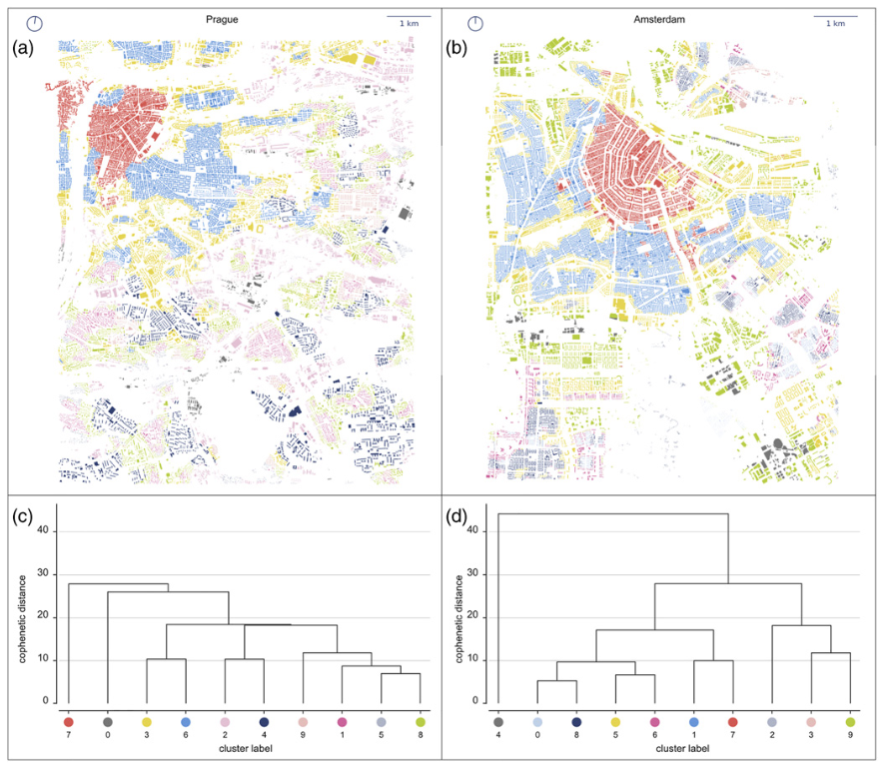
Clustering: partition data into groups
Spatial distribution of detected clusters in central Prague (a) and central Amsterdam (b) accompanied by dendrograms representing the results of Ward’s hierarchical clustering of urban form types in Prague (c) and Amsterdam (d).
Fleischmann, M., Feliciotti, A., Romice, O., & Porta, S. (2022). Methodological foundation of a numerical taxonomy of urban form. Environment and Planning B: Urban Analytics and City Science, 49(4), 1283-1299.

Slide 44
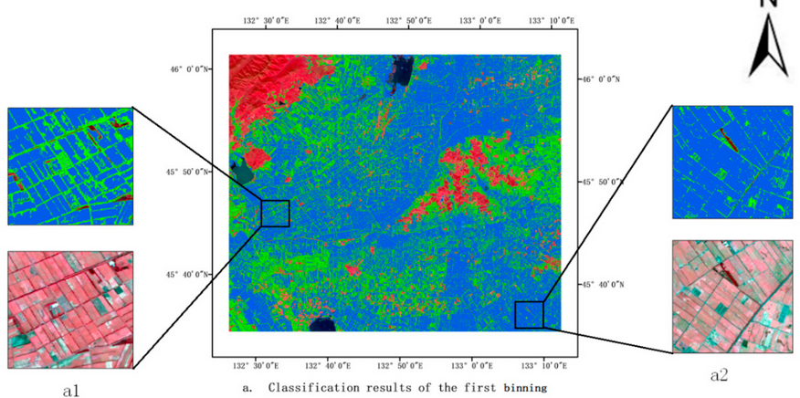
Clustering: partition data into groups
– IsoData imagery classification

Slide 45
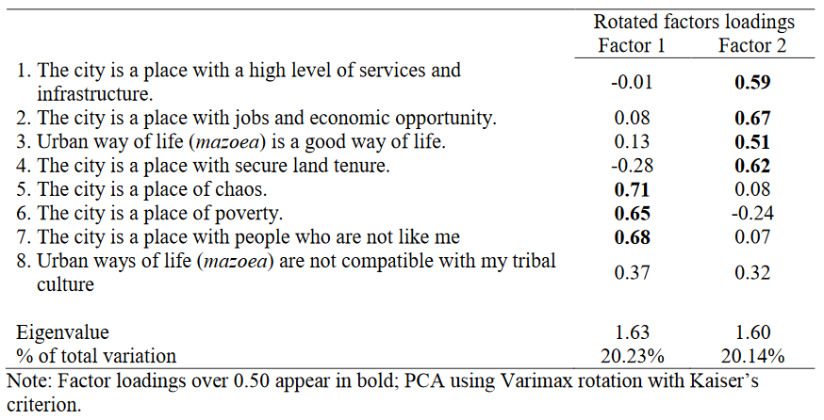
Dimensionality Reduction: Summarize a high-dimensional (many features) dataset with fewer features
Table 4: Summary of rotated factor loadings based on PCA for 8 items on Perception of cities

Slide 46
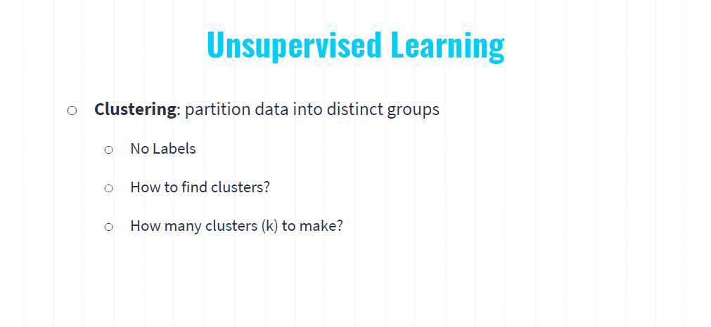

Slide 47
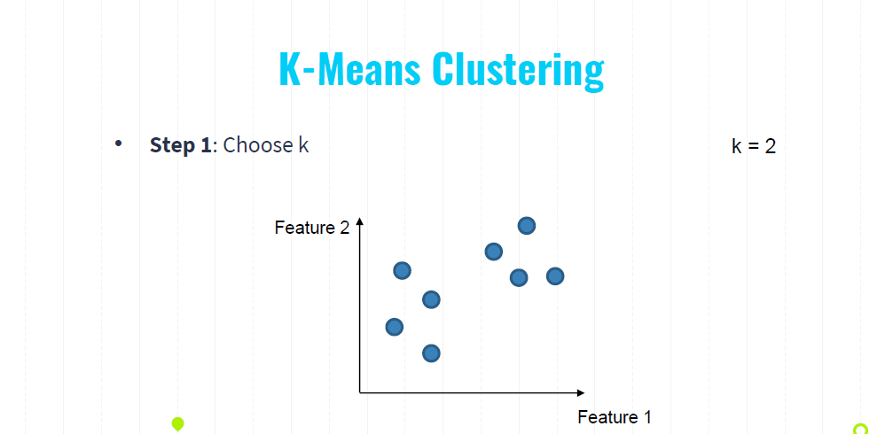
Notes:
You can easily identify by eye, however, how to make computers to do this for us?

Slide 48
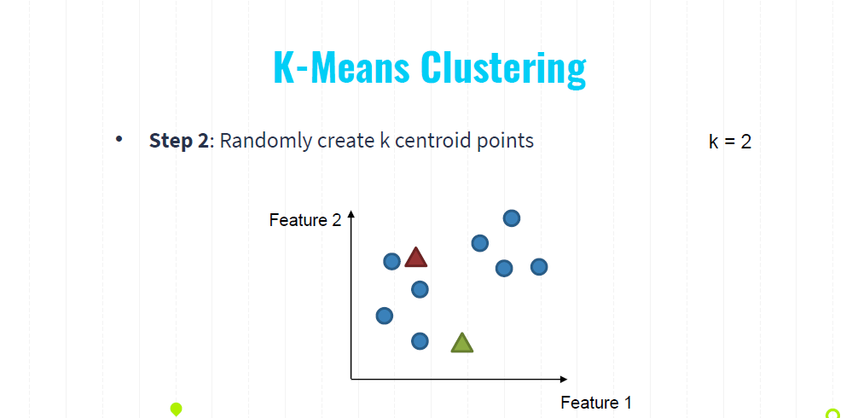

Slide 49
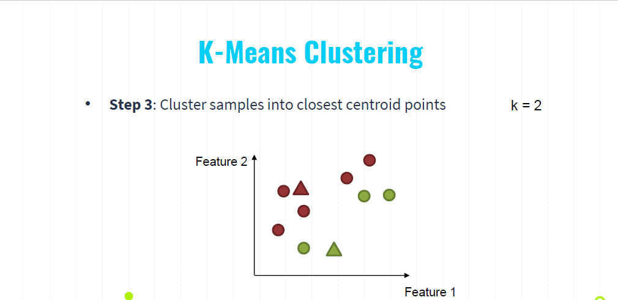

Slide 50
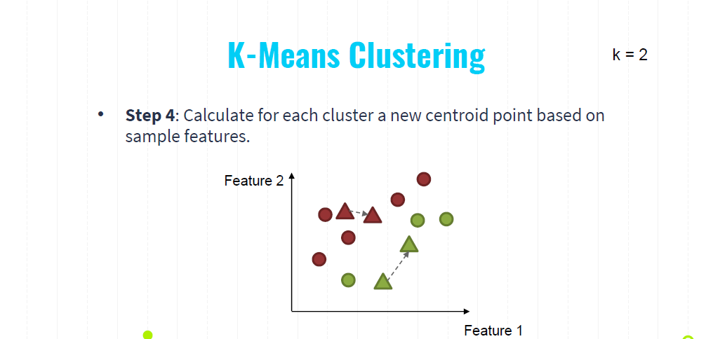

Slide 51
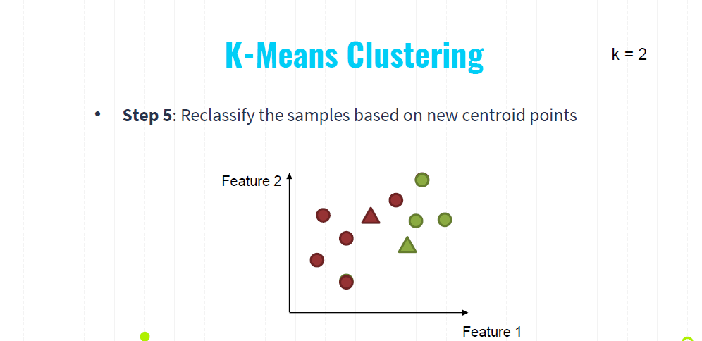

Slide 52
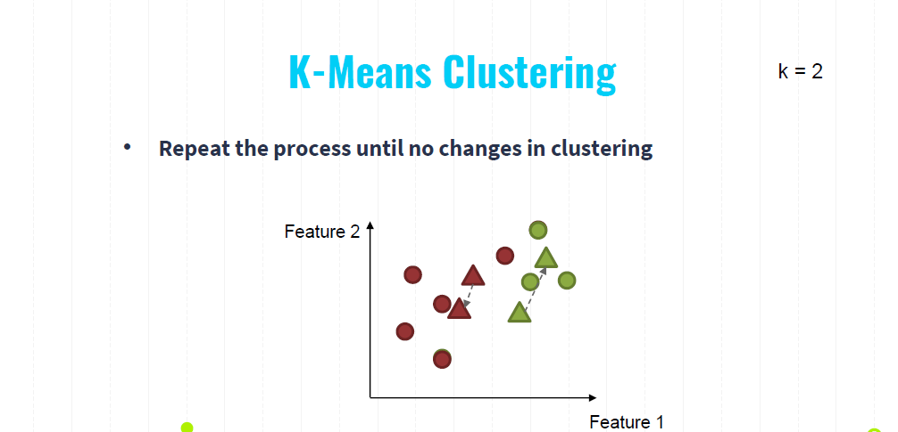

Slide 53
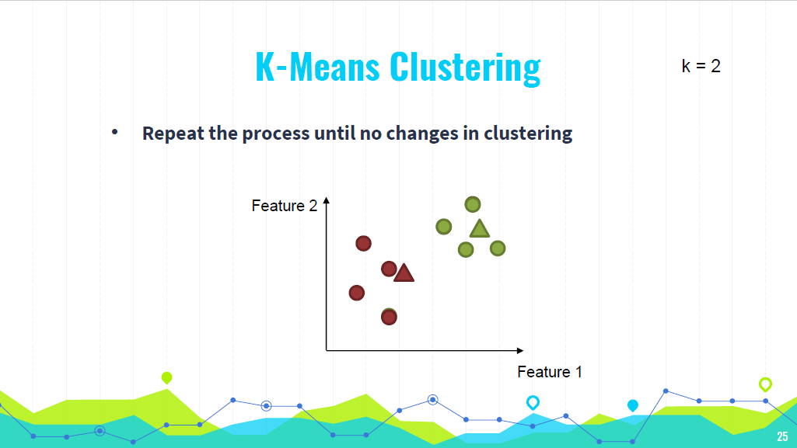

Slide 54
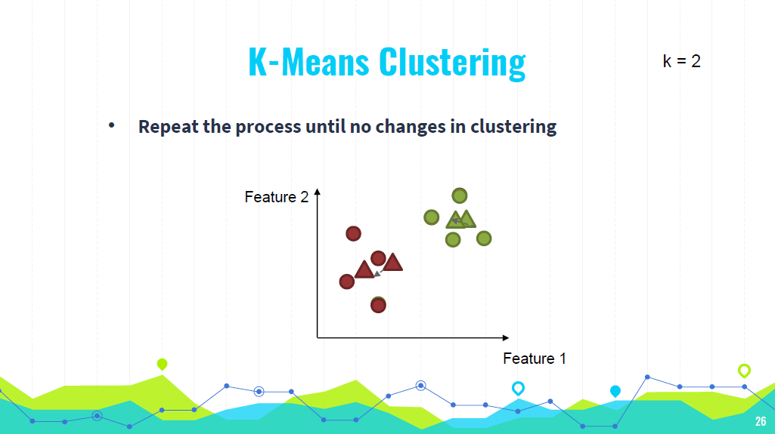

Slide 55
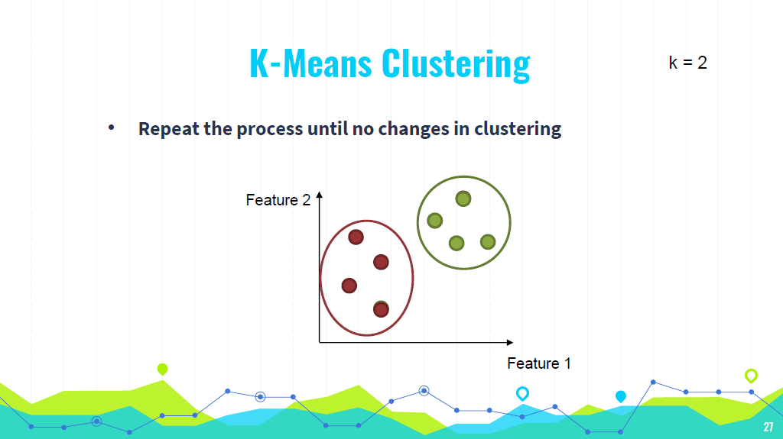

Slide 56
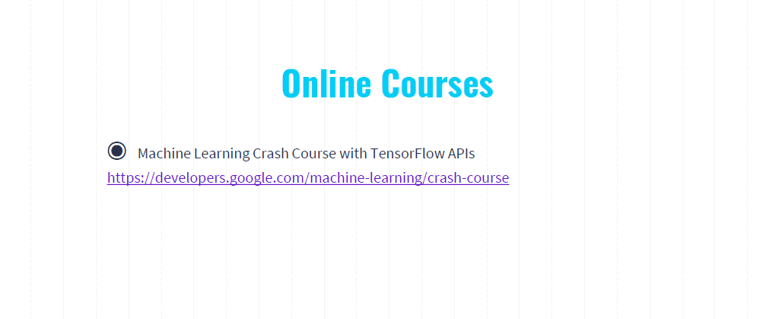
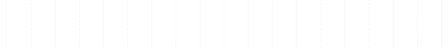
◉Machine Learning Crash Course with TensorFlow APIs
https://developers.google.com/machine-learning/crash-course

Slide 57
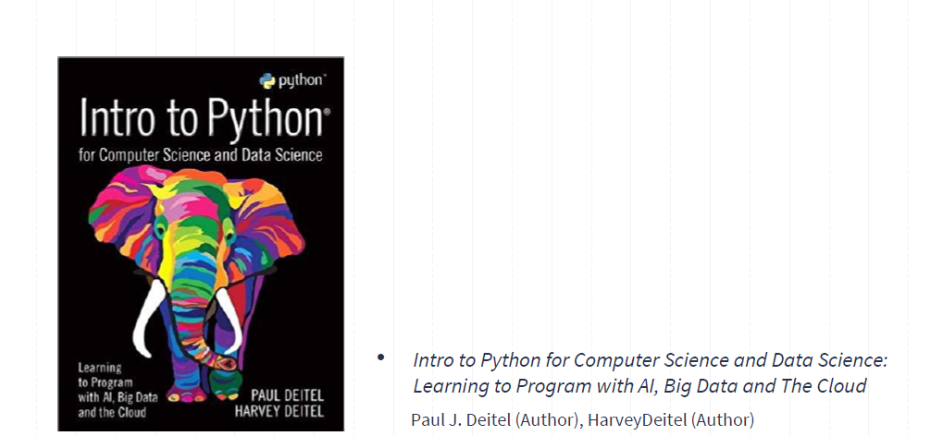

Slide 58
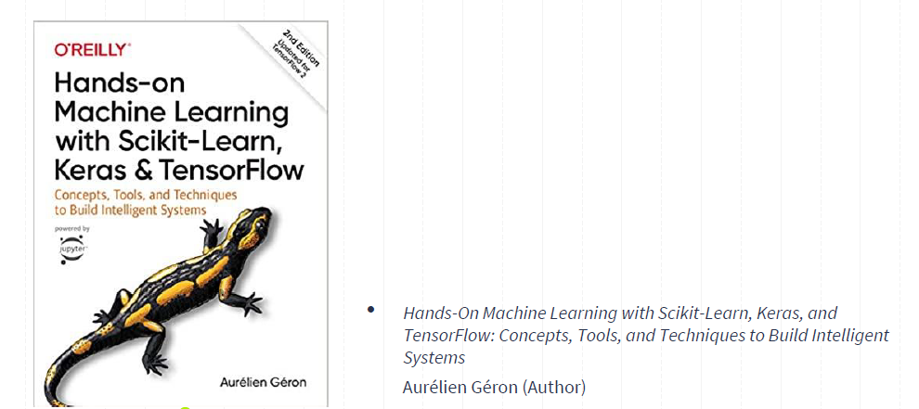

Slide 59
Q&A
Any questions?
You can find me at
wl563@cornell.edu
59

Slide 65
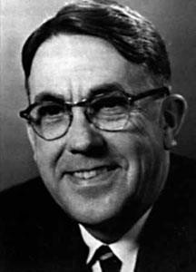
What is Machine Learning?
[Machine Learning is the] field of study that gives computers the ability to learn without being explicitly programmed.
---Arthur Samuel, 1959
Samuel, Arthur (1959). "Some Studies in Machine Learning Using the Game of Checkers". IBM Journal of
Research and Development. 3 (3): 210–229.
Notes:
was an American pioneer in the field of computer gaming and artificial intelligence.^{[2]} He popularized the term "machine learning" in 1959, and designed the world's first successful self-learning programs (let computers to play chess). His definition is:

Slide 66


What is Machine Learning?
Example 1: Spam Email Filter
Spam emails
Email System
Nonspam emails
Notes:
"Let's look at an example: a spam email filter. Imagine we want to create a system that filters spam emails.

Slide 67
What would you do to create such a system (machine)?
Task: filter spam emails
Spam emails
What are the conditions?
if conditions: it is a spam
else:
it is not a spam
bad words
ads (what are the ads)?
suspicious senders?
in title? In email body?
Not possible to write a rule to exhaust all cases!
Nonspam emails
Notes:
What would we do? We'd set conditions based on certain words, ads, suspicious senders, and other criteria. However, it's impossible to write a rule for every possible case."

Slide 68
What is Machine Learning?
Example 1: Spam Email Filter
Spam emails
Email System
Nonspam emails
Trained Machine

Slide 69

A spam filter based on machine learning
Spam
conditions:
bad words
ads (what are the ads)?
suspicious senders?
in title? In email body?
Spam
Good
Spam
Training
Good
Good
Good
Spam emails
Nonspam emails
Prediction
Notes:
Let computers to learn to summarize, and build the rules for us.

Slide 70






What is Machine Learning?
Example 2: Image Recognition
Task: whether there is a table in the image
10
Notes:
Let us take an example here. Image recognition. The task is for the computers to identify whether there is a table in the image.

Slide 71

A table detector based on machine learning
conditions:
Flat Surface?
Legs or Support?
Height Consistency?
Edges and Corners?
Shadows and Reflections?
Yes
Training
No
Yes
Yes
Yes
No
Prediction
11
Notes:
So we firstrly tell computers which one is a tbale>? Then computers can learn and summarize certain patterns (or common features) of the table.

Slide 72
What is Machine Learning?
We want a machine which can predict output accurately (most of time) based
on input data.
Input
Trained
Output
Spam
Spam
Spam
Good
Rules
Good
72
Notes:
We want a machine which can predict output accurately (most of time) base on input data. We do not specify the rules for computers, we ask the computers to learn by itself.

Slide 73
What is Machine Learning?
Training
Input Output
Rules
Spam
Spam
Spam
Good
Good
73
Notes:
And then summarize the rules for us.

Slide 74

What is Machine Learning?
Training
label
Training set
instance
Spam
?
Good
Spam
New instance
74
Notes:
Then applies the rule to the new instance to judge whether this instance is a spam or not.

Slide 75
Supervised Learning
Training
label
Training set
instance
Spam
?
Good
Spam
New instance
1. Supervised Learning: machine is trained with human supervision
with a “teacher”, (the training set is labeled)
75

Slide 76
Then, what is unsupervised learning?
1. Supervised Learning: machine is trained with human supervision
with a “teacher”, (the training set is labeled)
2. Unsupervised Learning: machine is trained without human supervision
without a “teacher”, (the training set is not labeled)
76

Slide 77
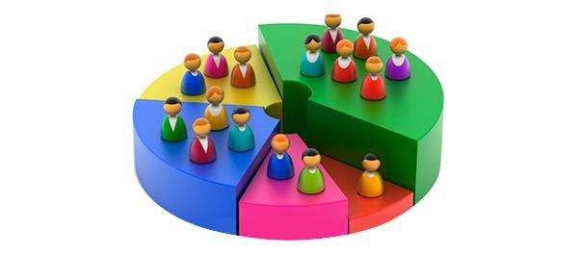
Unsupervised Learning
We want to classify customers into different types based on their attributes
77

Slide 78
Unsupervised Learning
We want to classify customers into different types based on their attributes
Clustering data based on identified patterns or structures.
Input
Trained
Output
We do not know the output!
78
Notes:
Unsupervised learning is a type of machine learning where the model is trained on data without labeled outcomes. The goal is to discover hidden patterns, structures, or features within the data.
One common task in unsupervised learning is clustering, where we group data points into clusters based on their similarities.
Input: The dataset containing customer attributes.
Trained Model: The model processes the input data to find patterns or clusters.
Output: The resulting clusters, which categorize customers into different groups based on identified patterns.

Slide 79
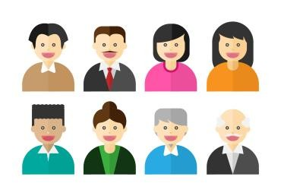

Unsupervised Learning
Training
Training set
instance
?
No label
New instance
2. Unsupervised Learning: machine is trained without human supervision
without a “teacher”, (the training set is not labeled)
79
Notes:
Of course, the results will not be labeled. We need to interpret them by ourself.
Unsupervised learning does not always require separate training and testing sets in the same way that supervised learning does.
(0) Generalization Check: Even without labels, it's important to ensure that the patterns or structures identified by the algorithm generalize well to new, unseen data. Splitting the data helps to validate that the model performs consistently across different subsets of data. Avoiding Overfitting
(1) Stability and Robustness: By applying the algorithm to different subsets (e.g., through cross-validation),
(2) Hyperparameter Tuning: Some unsupervised learning algorithms, such as K-Means, have hyperparameters (e.g., the number of clusters) that need to be set. By splitting the data, you can use a portion of the data to tune these hyperparameters and the rest to validate the results.
(3) Algorithm Comparison: When comparing different algorithms or variations of the same algorithm, using separate sets can help ensure that comparisons are fair and not overfitted to a single dataset.

Slide 80
Machine Learning Types
1. Supervised Learning: machine is trained with human supervision
with a “teacher”, (the training set is labeled)
2. Unsupervised Learning: machine is trained without human supervision
without a “teacher”, (the training set is not labeled)
Semisupervised Learning
Reinforcement Learning
80
Notes:
Techniques for Validation in Unsupervised Learning:
Cronbach's alpha: check the consistency between samples.
Comparison with Ground Truth
Bootstrap Method: Repeatedly sample from the dataset and apply clustering to each sample. Assess the variability of the clustering results.
Unsupervised learning does not always require separate training and testing sets in the same way that supervised learning does.
(0) Generalization Check: Even without labels, it's important to ensure that the patterns or structures identified by the algorithm generalize well to new, unseen data. Splitting the data helps to validate that the model performs consistently across different subsets of data. Avoiding Overfitting
(1) Stability and Robustness: By applying the algorithm to different subsets (e.g., through cross-validation),
(2) Hyperparameter Tuning: Some unsupervised learning algorithms, such as K-Means, have hyperparameters (e.g., the number of clusters) that need to be set. By splitting the data, you can use a portion of the data to tune these hyperparameters and the rest to validate the results.
(3) Algorithm Comparison: When comparing different algorithms or variations of the same algorithm, using separate sets can help ensure that comparisons are fair and not overfitted to a single dataset.
# Why unsupervised learning still wants training set:
(1)

Slide 81

Traditional Program
Input
Output
Rules
Input
Machine Learning
Rules
Output
5

Slide 82
2
Supervised Learning
82

Slide 83
Supervised Learning
Associating features with some label.
Two tasks :
Classification: labels as discrete categories
Spam email or not
With a table or not
Regression: labels as continuous quantities.
Housing price
categorical
Output
numeric
Input
Trained
25
Notes:
is a type of machine learning where the model is trained on a labeled dataset. In this context, "labeled" means that each training example is paired with an output label. The goal of supervised learning is to learn a mapping from inputs to outputs that can be used to make predictions on new, unseen data.

Slide 84
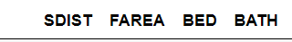
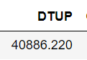
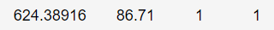
Understand Machine Learning
What do I mean if I want to build a machine learning model for my housing transaction dataset?
Input
Housing datasets with attributes
Trained
Output
Housing prices

Slide 85
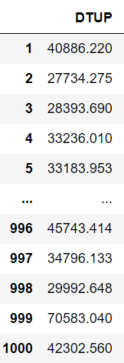
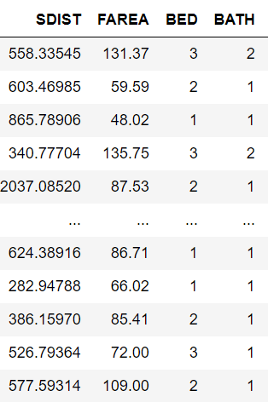
Understand Machine Learning
target
features
Output
Input
Features, also known as attributes or variables, are the individual measurable characteristics of the data that are used as input.
The target, also known as the label or dependent variable, is the outcome or value that the machine learning model is trying to predict.

Slide 86
Understand Machine Learning
SDIST
BATH
DTUP
FAREA
BED
How about a linear regression model?
o Linear regression is a type of machine learning model
𝑫𝑻𝑼𝑷 = 𝛽₀ + 𝛽₁𝑺𝑫𝑰𝑺𝑻 + 𝛽₂𝑭𝑨𝑹𝑬𝑨 + 𝛽₃𝑩𝑬𝑫 + 𝛽₄𝑩𝑨𝑻𝑯 + 𝜀

Slide 87
Supervised Learning
Two tasks :
Classification: output is categorical
Spam email or not
With a table or not
Logistic Regression is here!!!
o Regression: output is numeric
O Housing price
Linear Regression is here!!!
categorical
Output
numeric
Trained
Input
29

Slide 88
Machine Learning vs. Statistics
𝑫𝑻𝑼𝑷 = 𝛽₀ + 𝛽₁𝑺𝑫𝑰𝑺𝑻 + 𝛽₂𝑭𝑨𝑹𝑬𝑨 + 𝛽₃𝑩𝑬𝑫 + 𝛽₄𝑩𝑨𝑻𝑯 + 𝜀
Machine learning cares about prediction
field of predictive modeling
concerned with minimizing the prediction error or making the most accurate predictions
borrow algorithms from statistics for predication purposes
Statistics cares about estimation and inference
field of statistical modeling
understanding the relationship between variables
many models/algorithms have been borrowed by machine learning.
88

Slide 89
Machine Learning vs. Statistics
Statistics: hypothesis testing, model assumptions, explanation, and interpretation
In machine learning, different than in applied statistics, we are less interested in what these parameters are, and more in how well they can
Make predictions
Describe underlying structures or characteristics in the data

Slide 90
3
Machine Learning Algorithm

Slide 91
Machine Learning
Algorithm
Input
Machine Learning
Rules
Output
14

Slide 92
Algorithm
In mathematics and computer science, an algorithm is a finite sequence of well-defined, computer-implementable instructions, typically to solve a class of problems or to perform a computation. (Wikipedia)
92

Slide 93
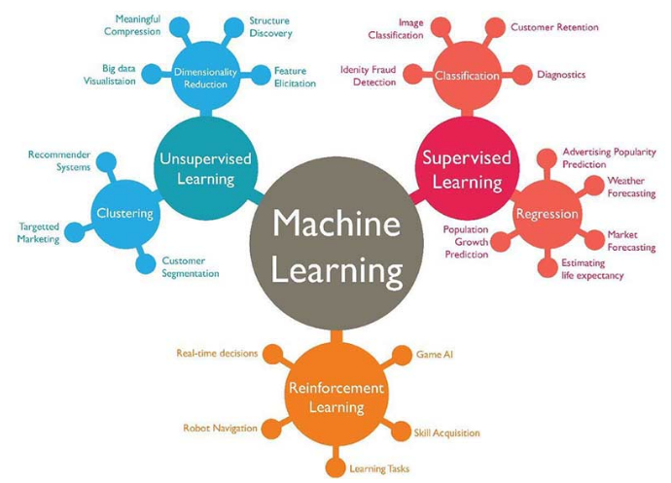
Machine Learning Algorithm
Supervised learning
Classification
K-nearest neighbors
logistic regression
Random forest
…
Regression
Linear regression
…
Unsupervised learning
Clustering
K-means clustering
…
Dimensionality Reduction
PCA and factor analysis
…
93

Slide 94
Algorithm Example: Linear Regression
Supervised learning
o Regression Problem
𝒚
𝒚 | 𝒙_{𝟏}
20000 | 800
60000 | 2000
14000 | 632
54000 | 1800
20000 | 750
20000 | 400
… | …
𝑦_{𝑖} = 𝛽₀ + 𝛽₁𝑥_{1𝑖} + 𝜀_{𝑖}
OLS: Ordinary Least Squares
𝒙_{𝟏}
minimize sum of squared errors

Slide 95
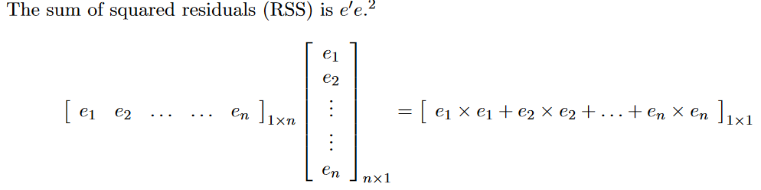





Algorithm Example: Linear Regression
We need to take the derivative of the above equation:
https://web.stanford.edu/~mrosenfe/soc_meth_proj3/matrix_OLS_NYU_notes.pdf

Slide 96
Algorithm Example: Classification
y = 0
y = 1
Supervised learning
Classification Problem
Binary Choice
𝒚
𝒙_{𝟏}
800
0
1
0
1
1
0
…
2000
632
1800
750
400
…
?
?
?
𝒙_{𝟏}

Slide 97
Algorithm Example: Logistic Regression
y = 0
y = 1
Supervised learning
o Classification Problem
Binary Choice
𝒚
𝒚 | 𝒙_{𝟏}
0 | 800
1 | 2000
0 | 632
1 | 1800
1 | 750
0 | 400
… | …
1
0.5
exp(𝛽₀ + 𝛽₁𝑥_{1𝑖})
𝑃(𝑦
𝑖
= 1|𝑥 ) =
?
?
?
1𝑖
1 + exp(𝛽 + 𝛽 𝑥 )
0 1 1𝑖
0
𝒙_{𝟏}
MLE: Maximum Likelihood Estimation
Notes:
sigmoid function. The output of the sigmoid function is a probability value between 0 and 1. This probability is used to classify the input into one of the two classes. For binary classification, a common threshold is 0.5, where values above 0.5 are classified as one class and values below 0.5 as the other class.

Slide 98
Algorithm Example: K-Nearest Neighbors
y = 0
y = 1
Supervised learning
Classification Problem
Binary Choice
?
?
?
𝒙_{𝟏}
𝒚
𝒙_{𝟏}
800
0
1
0
1
1
0
…
2000
632
1800
750
400
…
Notes:
the K-Nearest Neighbors (KNN) algorithm does not perform an explicit training phase like many other machine learning algorithms. Instead, KNN is often referred to as a "lazy learner" because it simply stores the training data and makes predictions by calculating distances to the known data points when a query is made.
The number of nearest neighbors (k) to consider when making a prediction. The choice of k affects the algorithm's performance:Small k: Can lead to a model that is sensitive to noise in the training data (overfitting).
Large k: Can lead to a model that is too generalized (underfitting).

Slide 99
Algorithm Example: K-Nearest Neighbors
y = 0
y = 1
Supervised learning
Classification Problem
Binary Choice
?
?
?
𝒙_{𝟏}
𝒚
𝒙_{𝟏}
800
1 Nearest Neighbor
0
1
0
1
1
0
…
2000
𝒙
632
𝟏
1800
750
400
…
Notes:
the K-Nearest Neighbors (KNN) algorithm does not perform an explicit training phase like many other machine learning algorithms. Instead, KNN is often referred to as a "lazy learner" because it simply stores the training data and makes predictions by calculating distances to the known data points when a query is made.
The number of nearest neighbors (k) to consider when making a prediction. The choice of k affects the algorithm's performance:Small k: Can lead to a model that is sensitive to noise in the training data (overfitting).
Large k: Can lead to a model that is too generalized (underfitting).

Slide 100
Algorithm Example: K-Nearest Neighbors
y = 0
y = 1
Supervised learning
Classification Problem
Binary Choice
?
?
?
𝒙_{𝟏}
𝒚
𝒙_{𝟏}
800
1 Nearest Neighbor
0
1
0
1
1
0
…
2000
𝒙
632
𝟏
1800
750
400
…
3 Nearest Neighbor
𝒙_{𝟏}
k Nearest Neighbor…
Notes:
the K-Nearest Neighbors (KNN) algorithm does not perform an explicit training phase like many other machine learning algorithms. Instead, KNN is often referred to as a "lazy learner" because it simply stores the training data and makes predictions by calculating distances to the known data points when a query is made.
The number of nearest neighbors (k) to consider when making a prediction. The choice of k affects the algorithm's performance:Small k: Can lead to a model that is sensitive to noise in the training data (overfitting).
Large k: Can lead to a model that is too generalized (underfitting).

Slide 101
Algorithm Example: K-Nearest Neighbors
Supervised learning
Classification Problem
Binary Choice
KNN is often referred to as a "lazy learner“
it simply stores the training data and makes predictions by calculating distances to the known data points
𝒚
𝒙_{𝟏}
800
The number of nearest neighbors (k) to consider when making a prediction
Small k: Can lead to a model that is sensitive to noise in the training data (overfitting).
Large k: Can lead to a model that is too generalized (underfitting).
0
1
0
1
1
0
…
2000
632
1800
750
400
…
Notes:
the K-Nearest Neighbors (KNN) algorithm does not perform an explicit training phase like many other machine learning algorithms. Instead, KNN is often referred to as a "lazy learner" because it simply stores the training data and makes predictions by calculating distances to the known data points when a query is made.
The number of nearest neighbors (k) to consider when making a prediction. The choice of k affects the algorithm's performance:Small k: Can lead to a model that is sensitive to noise in the training data (overfitting).
Large k: Can lead to a model that is too generalized (underfitting).

Slide 102
4
Machine Learning Steps
102

Slide 103
Machine Learning Steps
Gathering and loading data (what features to collect)
Exploring data (e.g., pandas and visualization)
Transforming data (e.g., string to numeric)
Splitting data for training and testing
Choosing and creating a model
Training
Testing (evaluating accuracy)
Tuning the model (hyperparameters)
Making predictions on new data
Data Preparation
103
Notes:
Most machine learning algorithms, especially those involving mathematical computations (like linear regression, logistic regression, and neural networks), require numerical input.
Label Encoding: Converts categorical labels into numerical values.
One-Hot Encoding: Converts categorical labels into numerical values.
Ordinal Encoding: Similar to label encoding but used for ordinal categories where there is an inherent order.

Slide 104
Transforming data (e.g., string to numeric)
Label Encoding: Converts categorical labels into numerical values.
["red", "green", "blue"] -> [0, 1, 2]
One-Hot Encoding: Converts categorical labels into numerical values.
["red", "green", "blue"] -> three dummy variables
Ordinal Encoding: Similar to label encoding but used for ordinal categories where there is an inherent order.
["low", "medium", "high"] -> [1, 2, 3]
Notes:
in certain scenarios, especially to avoid multicollinearity in linear regression models, you might use n−1n-1n−1 dummy variables instead. This approach is known as dummy variable trap avoidance.
Dummy Variable Trap
The dummy variable trap occurs when the dummy variables are highly correlated, meaning one dummy variable can be predicted from the others. This multicollinearity can cause problems in regression models, making it difficult to interpret the coefficients and potentially leading to numerical instability in the model estimation.

Slide 105
Training
target
features
Output
Input
Features, also known as attributes or variables, are the individual measurable characteristics of the data that are used as input.
The target, also known as the label or dependent variable, is the outcome or value that the machine learning model is trying to predict.
105
Notes:
The target, also known as the label or dependent variable, is the outcome or value that the machine learning model is trying to predict.

Slide 106

Splitting data for training and testing
Training set 75%
(80%)
Testing set 25%
(20%)
106

Slide 107

Machine Learning Steps
107

Slide 108

108

Slide 109

109
Notes:
The confusion matrix is a tool used to visualize the performance of a classification model. It helps us understand how many predictions were correct and where the model made mistakes.
Matrix Layout:
The rows represent the actual labels.
The columns represent the predicted labels.
Each cell in the matrix shows the count of instances for each combination of actual and predicted labels.
Now, we have two categories. So The matrix is divided into four quadrants
True Positives (TP): Predicted Spam and Actual Spam (top-left quadrant)
False Positives (FP): Predicted Spam but Actual Good (bottom-left quadrant)
False Negatives (FN): Predicted Good but Actual Spam (top-right quadrant)
True Negatives (TN): Predicted Good and Actual Good (bottom-right quadrant)

Slide 110
110
Notes:
a Type I error would mean marking a legitimate email as spam. This could result in missing important emails.
In medical testing, it could mean diagnosing a healthy person as having a disease, leading to unnecessary stress and treatment.
a Type II error would mean marking a spam email as legitimate.
In medical testing, it could mean failing to diagnose a person with a disease

Slide 111
111
Notes:
Recall, also known as sensitivity or the true positive rate, measures how often the model correctly identifies positive instances (in this case, spam emails).

Slide 112
112
Notes:
Precision measures how often the model's positive predictions are correct. It focuses on the quality of the positive predictions made by the model.

Slide 113

113

Slide 114


Notes:
Prevalence (or support) is the count of actual instances of a particular class in the dataset. It is a raw count of how many times each class appears in the actual labels.

Slide 115


Slide 116


Slide 117

Notes:
Precision measures how often the model's predictions of each class is correct.

Slide 118

Cross-Validation
Is the Model Ready for Use?
Notes:
Selecting the Best Model: Cross-validation can be used to compare different algorithms and select the best-performing one.
Hyperparameter Tuning: Techniques like grid search or random search combined with cross-validation help in finding the optimal hyperparameters for the model.

Slide 119
Splitting the Data: The dataset is split into K equal-sized (or nearly equal-sized) subsets.
Training and Validation: The model is trained K times, each time using K-1 folds for training and the remaining 1 fold for validation.
Rotation: The validation fold is rotated such that each of the K folds is used exactly once as the validation set.
Averaging the Results: The performance metric (e.g., accuracy, precision, recall) is averaged across all K trials to give an overall performance estimate.

Slide 120
Notes:
Bias-Variance Tradeoff: A larger K results in lower bias but higher variance of the performance estimate. Conversely, a smaller K results in higher bias but lower variance.
Common Choices: Typically, K is set to 5 or 10, as these values have been shown to provide a good balance between computational efficiency and reliable performance estimates.

Slide 121


Slide 122
Machine Learning Steps
Gathering and loading data
Exploring data (e.g., pandas and visualization)
Transforming data (e.g., string to numeric)
Splitting data for training and testing
Choosing and creating a model
Training
Testing (evaluating accuracy)
Tuning the model (hyperparameters)
Making predictions on new data
122

Slide 123
Hyperparameter Tuning
Hyperparameter: model parameters specified in advance (before training)
What threshold to use?
What k to use?
?
𝒚
?
?
𝒙_{𝟏}
1 Nearest Neighbor
1
𝒙_{𝟏}
0.5
3 Nearest Neighbor
0.3
0
𝒙_{𝟏}
𝒙_{𝟏}
Logistic Regression
K-Nearest Neighbors

Slide 124

Notes:
Hyperparameter tuning refers to the process of optimizing the hyperparameters of a machine learning model to improve its performance. Hyperparameters are the parameters that are set before the learning process begins and are not learned from the data. They control the overall behavior and performance of the machine learning algorithm.

Slide 125
Machine Learning Steps
Gathering and loading data
Exploring data (e.g., pandas and visualization)
Transforming data (e.g., string to numeric)
Splitting data for training and testing
Choosing and creating a model
Training
Testing (evaluating accuracy)
Tuning the model (hyperparameters)
Making predictions on new data

Slide 126
5
Python and Machine Learning

Slide 127



Python and Machine Learning
Machine Learning
Deep Learning

Slide 128


Machine Learning Datasets
https://www.kaggle.com/datasets
https://www.openml.org/

Slide 129
Machine Learning is Great For
Problems for which transitional solutions require a lot of fine-tuning or long lists of rules
Complex problems for which the traditional approach yields no good solution
Fluctuating environments
Getting insights about complex problems and large amounts of data
129

